Slide 1
ARM Template

Slide 2
Topics
ARM Template
Advantages of ARM
Template Format
Parameters
Variables
Functions
Output
Azure Quickstart Template
Create and Deploy ARM Template

Slide 3
ARM Template
Azure Resource Manager (ARM) is a management framework used in Microsoft Azure to deploy, manage, and organize Azure resources.
ARM provides a way to create and manage resources consistently and predictably. In this blog, we will discuss what ARM is and how to use Azure Resource Manager Template (ARM Template), and how they are beneficial in automating the deployment.
Azure Resource Manager is a service that provides a way to organize resources in Azure. With ARM, you can define and deploy Azure resources as a single logical unit called a resource group.
This resource group can contain various Azure resources such as virtual machines, storage accounts, and network interfaces.

Slide 4
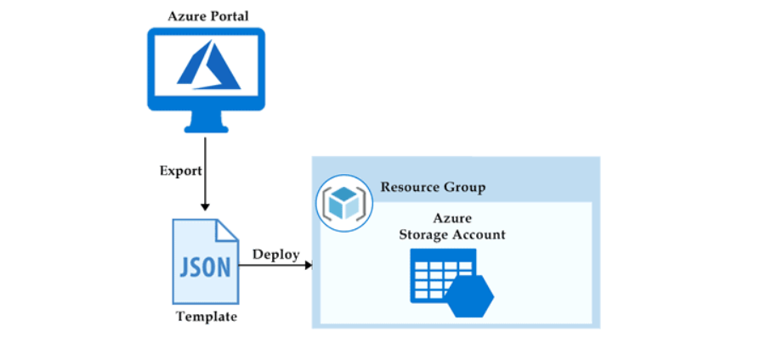
ARM Template

Slide 5
Advantages of ARM
Consistency: ARM provides a consistent way to create, deploy, and manage Azure resources.
Modularity: ARM enables you to define your infrastructure as a set of reusable templates, making it easier to manage and maintain.
Automation: ARM enables you to automate the deployment and management of your infrastructure, saving time and reducing errors.
Tagging: ARM enables you to tag your resources, making it easier to organize, track, and manage them.

Slide 6
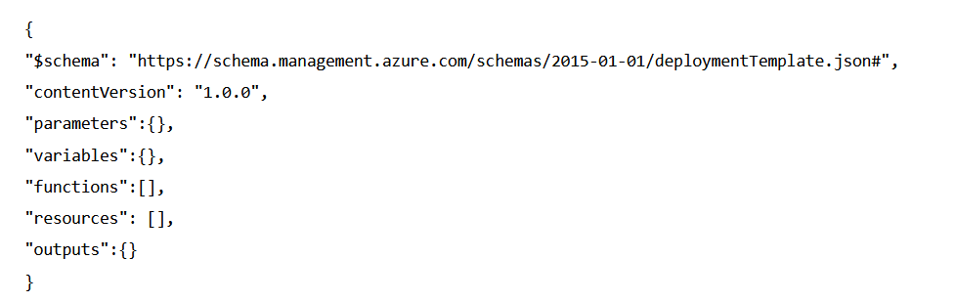
Template Format
The ARM Templates file contains various key-value pairs in JSON format. For example, below, you can see a format of ARM Templates.

Slide 7
Template Format
Schema – This ‘schema’ defines the location of the JSON file and specifies the version of the template language that you want to use in this template. This schema depends on the purpose of your deployment. Some schema types are listed below.
Resource Group Deployment – https://schema.management.azure.com/schemas/2019-04-01/deploymentTemplate.json#
Subscription Group Deployment – https://schema.management.azure.com/schemas/2018-05-01/subscriptionDeploymentTemplate.json#
Management Group Deployment – https://schema.management.azure.com/schemas/2019-08-01/managementGroupDeploymentTemplate.json#
Tenant Group Deployment – https://schema.management.azure.com/schemas/2019-08-01/tenantDeploymentTemplate.json#
Content Version – It specifies the version of the templates. This version can be any number that you want to give to your template.

Slide 8
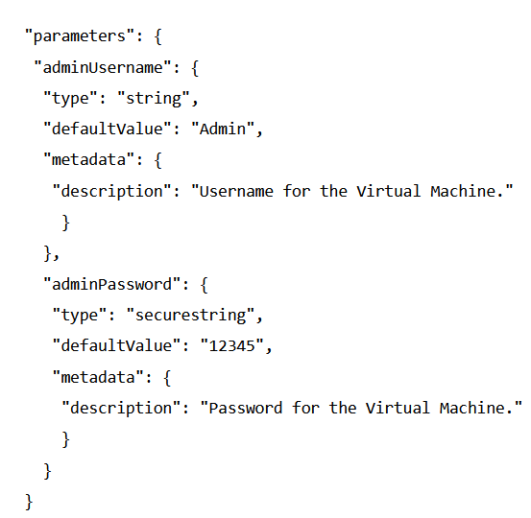
Parameters
Parameters in templates define the configuration. These parameters are used in run time or during deployment. In a parameter, we need to define the name, type, values, and properties.
We can also set some allowed values and default values to the parameters, so when a value is not passed during deployment, then the default or allowed values will be used.
Below is an example of parameters that defines the type and the default value of username and password for the VM (Virtual Machine).

Slide 9
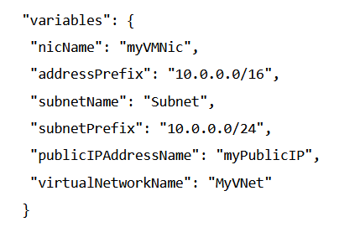
Variables
Variables define values used throughout the template. In simple words, you can define a short name for a specific value that can be used anywhere in the template.
Variables also become an advantage when you want to update all the values and references in a template. Then you can update the variable and its value only.

Slide 10
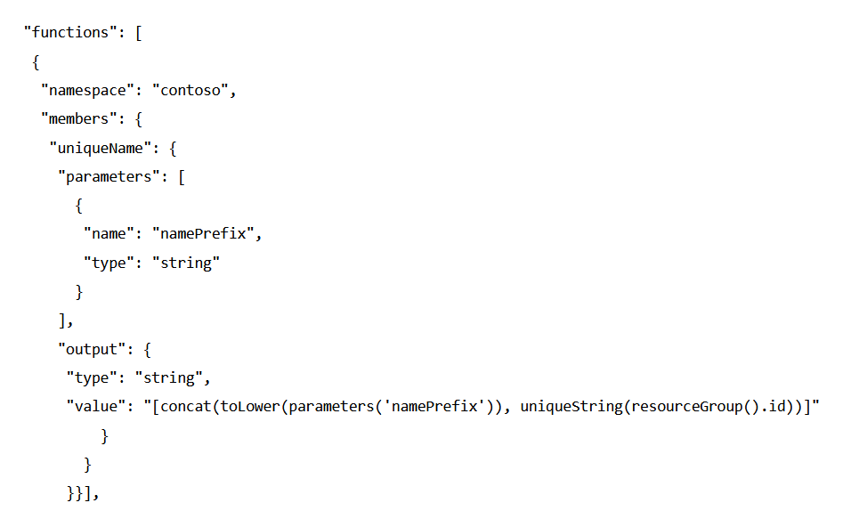
Functions
In a template, the function contains the steps and procedures to be followed. It is just like a variable that defines the steps performed when called in templates. The below example of the function defines the unique name for the resources.

Slide 11
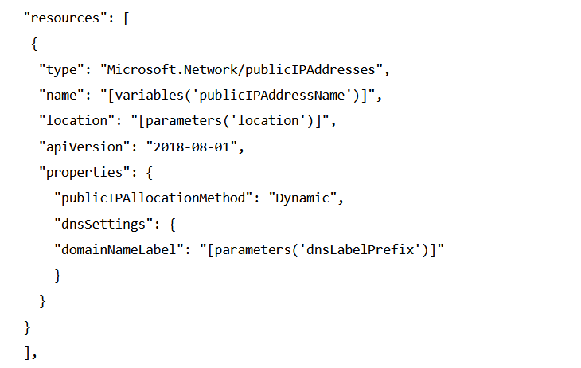
Resources
All the azure resources are defined here which makes the deployment.
For creating a resource, we need to set up the type, name, location, version, and properties of the resource that needs to be deployed.
We can also use the variables and parameters here that are defined in the ‘variables’ section. Below is an example of declaring the resources in templates.

Slide 12
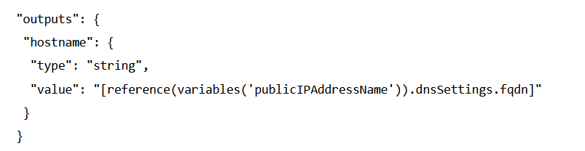
Outputs
Output defines the result that you want to see when a template runs. In simple words, the final words that you want to see when a template is successfully deployed. In the below example, the hostname with a value fetched from the public IP address name.

Slide 13
Azure Quickstart Template
Azure Quickstart Templates are ready to deploy sample templates.
The Microsoft community creates these templates. You will find various Azure Quickstart templates on Microsoft’s official site like creating a VM (Virtual Machine), deploying the VM, etc.
A beginner can use these quickstart templates to get familiar with the concept.
After visiting the Azure QuickStart Template portal, you will see some template samples.
Click on any sample and then choose ‘Browse on Github‘. Next, you can click on the ‘Visualize‘ button to see the preview of templates.
Finally, you can choose the ‘Deploy‘ option to deploy the template to your Azure Portal.

Slide 14
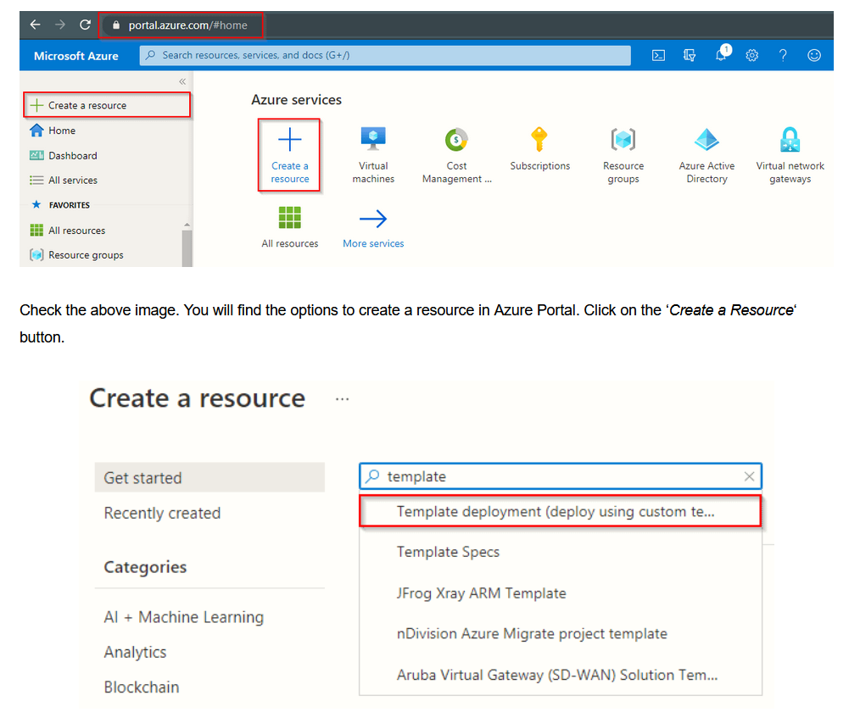
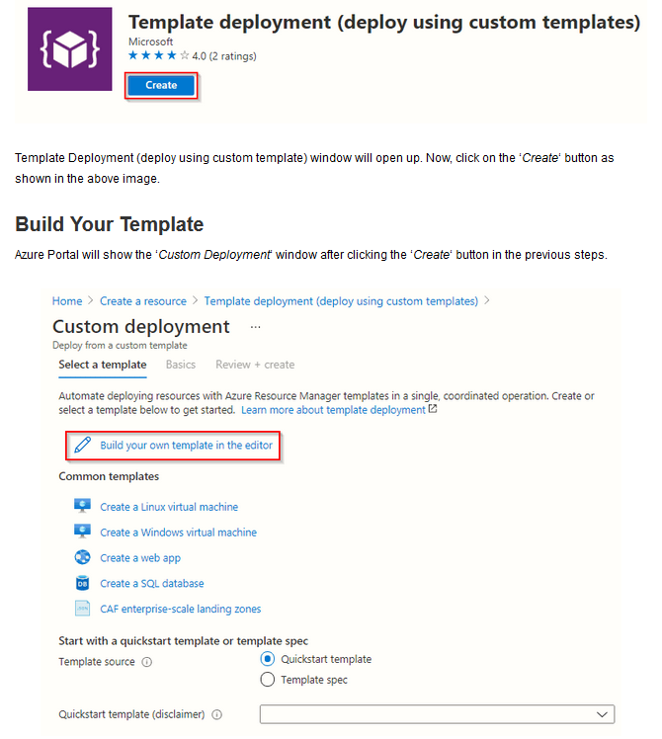
Create and Deploy ARM Template

Slide 15
Official Docs
https://learn.microsoft.com/en-us/azure/azure-resource-manager/templates/deploy-cli

